Slide 1
COVID-19
CMS Testing Requirements

Slide 2

COVID-19
CMS Testing Requirements
Date TBD
Harmony Healthcare International (HHI)
“HHI C.A.R.E.S. about Care”

Slide 3
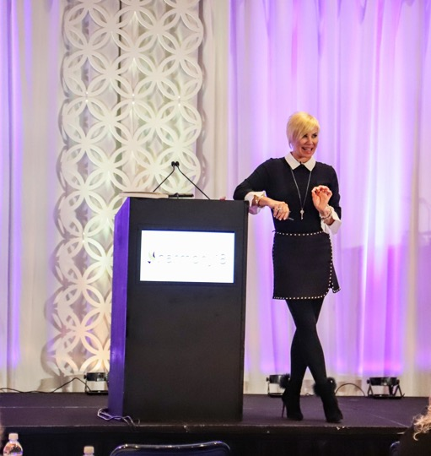

About Kris
Kris Mastrangelo OTR/L, LNHA, MBA
President and CEO
Owns and operates
Harmony Healthcare International (HHI) a Nationally recognized, premier Healthcare Consulting firm specializing in C.A.R.E.S. There are no nonfinancial disclosures to share.
“HHI C.A.R.E.S. About Care.”

Slide 4

Marvelous Monday
Special Offer
Online access
Five-Star
Health Inspections
Staffing (PBJ and CMI)
Quality Measures
at a Discounted Rate
Today Only!
$69.99
Retail Value $199
Place Order Today 4.27.20

Slide 5


Slide 6




Slide 7


Slide 8



Slide 9


Slide 10
Educational Activity Completion
Requirements for Successful Completion
1 contact hour will be awarded for this continuing nursing education activity. Criteria for successful completion includes:
Attendance for 100% of the 1-day course or individual, 3 hour module (2 and 3 day trainings requires at last 80% attendance). Contact hours will be awarded for time
Must complete post course exam within 2 weeks of the course and course/teacher evaluation.
Clearly demonstrate the learning outcome of the program.
Participants will receive a certificate of completion immediately following completing the above requirements.
Harmony

Slide 11
CEU Disclosure
Approval of this continuing education activity does not imply endorsement by ANCC (American Nurses Credentialing Center) of any commercial products or services.
Approval of this continuing education activity does not imply endorsement by AOTA and NAB of any commercial products or services.
Harmony Healthcare International (HHI) is accredited as a provider of continuing nursing education by the American Nurses Credentialing Center’s Commission on Accreditation.
Harmony Healthcare International (HHI) is accredited as a provider of continuing education by the American Occupational Therapy Association.
Harmony Healthcare International (HHI) is accredited as a provider of continuing education by the National Association of Long-Term Care Associations Boards.

Slide 12
Speaker and Planning Committee
Disclosure
Disclosures: The planners and presenters of this educational activity have no relationship with commercial entities or conflicts of interest to disclose. Please visit https://www.harmony-healthcare.com/hhi-team for all speaker’s financial and nonfinancial disclosures
Planners:
  Kris Mastrangelo, OTR/L, LNHA, MBA
  Joyce Sadewicz, PT, RAC-CT
  Pamela Duchene, PhD, APRN-BC, NEA, FACHE
Presenter:
  Kris Mastrangelo, OTR/L, LNHA, MBA

Slide 13
Learning Objectives
Identify documentation requirements necessary to support compliance with testing for COVID-19.
Identify routine COVID-19 testing intervals for staff, how to determine them and when to test residents.
Verbalize an understanding of the guidance for F886 and the updates to the COVID-19 Focused Survey
Understand reporting of COVID-19 testing results.

Slide 14
Effective September 2, 2020
New Federal Testing Requirements Apply To
All staff
Employees
Contractors
Consultants
Volunteers
All residents
When an outbreak occurs
Symptomatic testing: anyone with signs or symptoms of COVID-19
Notes:
Employees – regardless of job title
May be effective a bit later depending on testing frequency required for the county (9.9.20, 9.22.20)

Slide 15
Types of COVID-19 Testing
Viral Test
Tells you if you have a current infection
PCR testing detects virus’ genetic material
Antibody Test
Tells you if you had a past infection
Serology test that looks for antibodies against COVID-19 in a blood sample to determine past infection
Antigen testing detects specific proteins on the surface of the virus
Notes:
A viral test tells you if you have a current infection. It is a diagnostic test.
An antibody test or serology test might tell you if you had a past infection. It is not a diagnostic test.
From SCDHEC (SC DOH):
1. Polymerase Chain Reaction (PCR) or Nucleic acid amplification test (NAAT): This type of testing, also called molecular or viral testing, is done by swabbing the nose or mouth or collecting saliva. The test detects a part of the virus’s genetic material. It is currently considered the best test to determine if someone was recently infected with the virus, but people can continue to test positive with this test long after they are no longer contagious and are no longer at risk of spreading the virus. CDC provides further information on this type of testing.
Limitations:
The virus must be present at a level high enough for the test to detect it. There is a delay between the time a person is exposed and the time the virus level gets high enough for the test to be positive.
A negative test does not rule out the possibility of that person soon becoming sick with the virus. If someone is tested too soon after being exposed to the virus, they may have a negative test even though they will soon become contagious with the virus.
Someone who has been instructed to quarantine after an exposure to a person with COVID-19 cannot shorten the length of their quarantine period even if they test negative because it is possible they were tested at a time when the virus was not detectable.
If someone has symptoms of COVID-19, the virus can usually be reliably detected by this test; and a negative test suggests the symptoms are not due to the COVID-19 virus.
A positive test does NOT necessarily mean that the person is still contagious with the virus. The timing of the symptoms or the test should be used to determine if someone can still spread the virus.
2. Antigen tests: These tests are done by swabbing the nose. Instead of detecting the virus’ genetic material, they detect a protein on the virus. These are often available as “rapid” tests that can be done in medical offices. The faster results make this a very useful test.
Limitations:
These tests may not detect lower levels of virus and could produce more “false negatives.” Results of these tests should be interpreted with that in mind.
Those who test positive on a viral test (PCR or antigen) do not need additional testing within the three (3) months following symptom onset or test specimen collection.
3.. Blood test, antibody or serology testing: This testing is done using a sample of blood and detects antibodies produced as a result of the body trying to fight off the virus. These tests are most useful for determining if someone has been exposed to the virus in the past. These tests are NOT recommended to determine if someone is currently infected. CDC provides further information on these types of tests.
Limitations:
It can take 1 to 3 weeks after the exposure to virus for antibodies to rise to a level high enough for the test to detect them. You may be currently infected but have a negative antibody test.
We are still learning about these tests and whether or not the antibodies they detect could protect against future infection. No one should consider themselves immune to COVID-19 infection based on these results. Precautions should still be taken to protect against future infections, even if you test positive for antibodies.

Slide 16
Testing Window
Molecular PCR Test
Days 1-28 after sx onset, may have + results up to 120 days
Antigen Test
Days 5 -7 Authorized for after sx onset
Serology Test
IgA/IgM
Day 5 after sx onset, optimal 14-21
IgG: Day 14 after sx onset up to 6 weeks

Slide 17
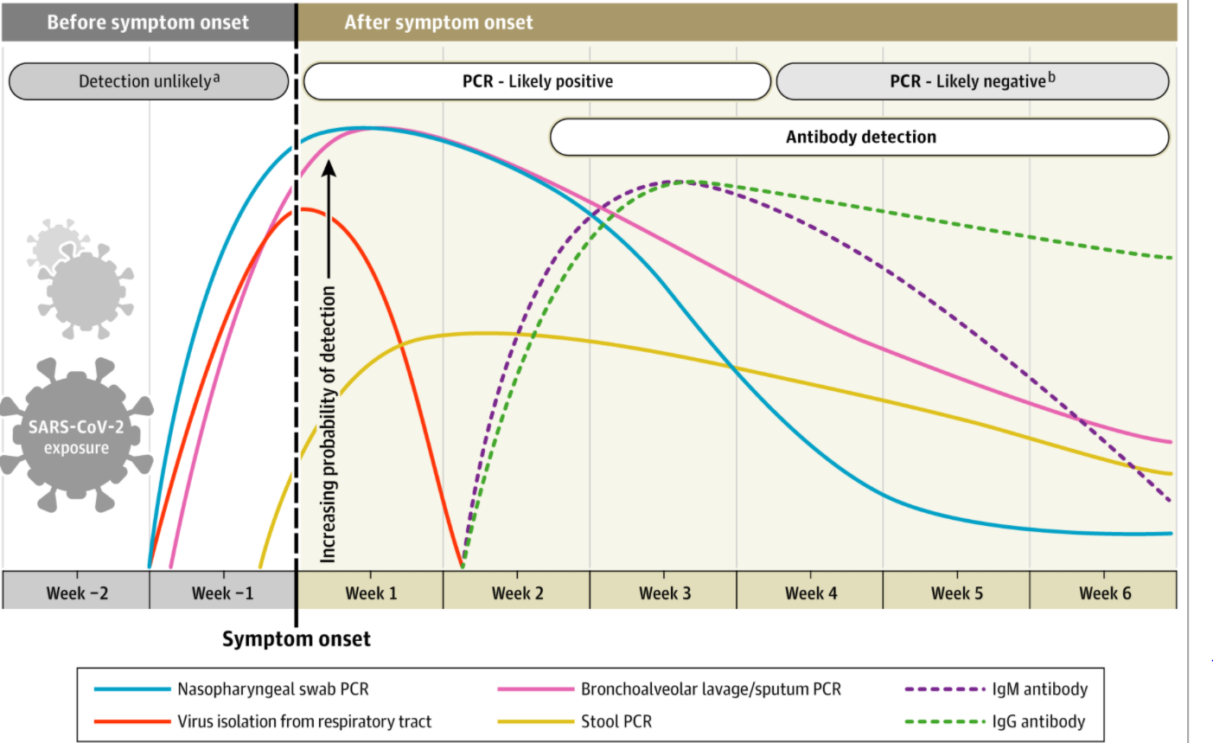
COVID-19 Infection Timeline & Testing
Sethuraman N et al. JAMA May 2020
DOI: 10.1001/jama.2020.8259
Notes:
How to use tests
At left you see there is a window of time, as long as 2 weeks where an individual may be infected and incubating without any sx or any detectable virus or any test that would recognize that infection is present. Following the blue line shows that around 2 days prior to onset of sx you start to see viral detection through tests like PCR and is when viral diagnostic tests can be used. Over time it peaks, high for the first week or so and this is when active infection is recognized and you can use viral diagnostic tests. You can see viral levels are declining as the body’s immune system responds to the virus and antibodies to the virus develop. At this time you will not as readily see the virus present as your immune response is controlling the virus. There will be a window where the antibody will still be detectable and remain.

Slide 18
Routine Testing of Staff & Contractors
Test all staff based on the extent of the virus in the community using CMS’ county positivity rate.
PCR/Molecular or Antigen Tests
Notes:
Antibody tests do not meet requirement for testing, it is not a diagnostic test.

Slide 19
Facility Staff
Employee Students
Consultant Contractor
Volunteer, Caregiver
All Facility Staff
Notes:
Employees who do not work or do not enter the building and do not interact with residents (for example billing personnel that works elsewhere, construction or lawn/landscape personnel if they do not interact with any staff or residents) might be in your policy as not needing to be tested. It is also expected that the testing requirement does not apply to delivery personnel, EMTs who are not employees, consultants or contractors. You are not required to test family who are visiting or other visitors however you can offer them testing. Your policy should address providers who come into the building at a lower frequency than the required testing for the building. Consider POC testing devices for them or proof of recent results. It is recommended that you share your policy with your state survey office to see if they agree with your approach.
Facility staff includes employees, consultants, contractors, volunteers, and caregivers who provide care and services to residents on behalf of the facility. It also includes students in the facility’s nurse aide training programs or from affiliated academic institutions.

Slide 20
Your County Prevalence Rate
County-Level Positivity Rates
Published by CMS every week
Adjust Testing Frequency Based on Changes in the Positivity Rate
Check rates on the same day of the week every week
Rate increases → immediately adjust testing frequency
https://data.cms.gov/stories/s/COVID-19-Nursing-Home-Data/bkwz-xpvg
Rate decreases → continue testing staff at higher frequency until rate remains at lower level for at least 2 weeks
Notes:
This is the minimum testing expected.
Consider positivity rate in adjacent county, particularly if staff live there.
State and local officials may direct facilities to monitor other factors than increase the risk of transmission such as ED visits for those with COVID-19 like symptoms.
Sept update;
Posting changed from biweekly to weekly
Posting Frequency: CMS also clarified that it will post county data weekly​. It stated that facilities must check weekly and should pick one day of the week to check each week. They should document their plan for checking and document the dates used by CMS for the data in the top of the Excel file.
Using State or County Data: CMS has indicated on several national calls that facilities can use test positivity data released by their state or county if the data is more recent than the CMS data. The facility must document the source and date of the data being used.

Slide 21
Routine Testing of Staff & Contractors
Testing Frequency: County Positivity
GREEN
YELLOW
RED
Low = <5% or with less than 20 tests in 14 days
Medium = 5%-10% OR with <500 tests & <2,000tests/100k & >10% positivity over 14 days
High = >10% and not meeting criteria for Green or Yellow
Test once a month
Test once a week
Test twice a week
Notes:
Above is updated with Sept 29th guidance (on next slide) that states - Counties with 20 or fewer tests over 14 days will now move to “green” in the color-coded system of assessing COVID-19 community prevalence. Counties with both fewer than 500 tests and fewer than 2,000 tests per 100,000 residents, and greater than 10 percent positivity over 14 days – which would have been “red” under the previous methodology – will move to “yellow.” This information is critical to nursing homes, which are required to test their staff for COVID-19 at a frequency based on the positivity rate of their respective counties.

Slide 22
Testing Methodology
September 29th Update Addressed Rural Counties
Green
Counties with 20 or fewer tests over 14 days
Yellow
Fewer than 500 tests and fewer than 2,000 tests per 100,000 residents over 14 days
Greater than 10% positivity over 14 days
Notes:
AHCA and others requested changes on testing frequency – can really be unfair for small rural counties that are >10 due to very little testing that may have only 1 or 2 + COVID cases.

Slide 23
Routine Testing of Staff & Contractors
Individuals who have been COVID positive do not need repeat testing for 90 days.
Staff can be tested elsewhere in the correct timeframe with a documented result.

Slide 24
More Testing Triggers
Staff and Residents
Outbreak Testing
All staff and residents when an outbreak* occurs
Continue to test those who tested negative every 3-7 days until there are no new cases for at least 14 days since the most recent positive result
Symptomatic Testing
Anyone with signs or symptoms of COVID
* Outbreak = Any single new infection in staff or a resident who tests positive after admission.
Notes:
Symptoms of FLU and COVID-19 are similar. With Flu season, test for both
Complications in both
Resp: pneumonia, ARDS
Cardiac: myocarditis, pericarditis
Neuro: encephalitis
Sepsis: multiorgan failure
Secondary bacterial infections
Unique features of COVID-19:
• Up to 40% of people with COVID-19 have no symptoms.
• Olfactory symptoms are common (new loss of taste or smell)
Complications specific to COVID-19:
Hypercoagulability: MI, PE, DVT
Children: MIS-C
Post-COVID syndrome
What next?

Slide 25
Outbreak Testing Frequency
One positive infection in a staff member or resident
Test ALL staff and ALL residents immediately
Continue to test all negative staff and residents every 3 to 7 days until 14 days after the most recent positive result.
Notes:
Admitting a resident with COVID-19 does not trigger an outbreak, only a new nursing home onset infection.
As part of an outbreak response, CDC recommends that residents and HCP (who have not had a prior infection in the last 90 days) have viral testing (e.g., RT-PCR or antigen) immediately after the first new COVID-19 case is identified at the facility. Then the facility should perform serial testing of all residents and HCP who previously tested negative every 3–7 days until no new positive tests have been identified for 14 days. In nursing homes with outbreaks, most cases are identified within the first two weeks of diagnosing the first new case. These early cases likely occur among people who were previously exposed or were infected before more infection prevention and control (IPC) measures were implemented in response to the outbreak.
For this reason, if testing capacity allows and does not divert staff and resources away from performing other critical IPC measures (e.g., ensuring effective implementation of Transmission-Based Precautions for infected and potentially exposed residents), the facility should consider testing more frequently (e.g., every 3 days) for the first two weeks of the outbreak, then test less frequently (e.g., every 7 days) thereafter until no new cases are identified for 14 days. As an example, testing would occur on day 0 (day the first case is identified), days 3, 6, 9, and 12, and then on days 19, 26, etc.
This increased frequency of testing might not be possible in many facilities (e.g., lack of testing supplies or diversion of resources from other patient care activities). A minimum frequency of testing every 7 days is recommended until no new positive tests have been identified for 14 days. The effectiveness of increased frequency of testing is substantially diminished if IPC measures are not maintained. Facilities should ensure adherence to appropriate IPC measures in outbreak settings, including use of Transmission-Based Precautions for the care of all residents (even those who have negative tests) on affected units (or facility-wide, if cases are widespread). Facilities should also ensure rapid turnaround time of less than 2 days from specimen collection to test result.

Slide 26
Testing Asymptomatic Residents: Non-Outbreak
Should asymptomatic residents in NHs be tested regularly in a non-outbreak setting?
COVID is usually introduced into the NH by staff or visitors.
Testing asymptomatic residents can be reserved for a resident who has had close contact with someone confirmed as COVID +.
Regular testing can result in false positive results and then additional unnecessary testing.
Consider testing symptomatic residents who go out of the facility often for medical treatment when testing capacity allows.
Notes:
Unrecognized SARS-CoV-2 is most often introduced into a nursing home by asymptomatic healthcare personnel (HCP) or visitors with COVID-19 who work at or visit the nursing home, rather than residents. Recommendations for testing of residents who are asymptomatic in nursing homes is generally reserved for situations such as response to an outbreak in the facility (i.e., a new SARS-CoV-2 infection in any HCP or any SARS-CoV-2 infection in a resident) or evaluation of a resident who has had close contact with someone with confirmed SARS-CoV-2 infection.
Regular testing of asymptomatic residents can result in false-positive results and potentially result in additional unnecessary testing. If testing capacity allows, consideration could be given to regular serial testing of residents who are asymptomatic and who frequently leave the facility for medical treatment and then return (e.g. residents who receive regular hemodialysis, including those who are dialyzed at an onsite facility that treats nursing home and community patients), especially in communities where there is moderate to substantial community transmission. Such residents might be at higher risk for SARS-CoV-2 infections because of their frequent exposures outside the nursing home. These exposures can be from community patients, staff members during ambulatory care or during transportation; however, the benefit of serial testing of residents is not known.

Slide 27
Documentation is Required
Where?
In Medical or Employee Record
Separate file for contractors and volunteers
Results of tests must be in a secure manner consistent with standards for PHI, requirements in 483.80(h)(3)

Slide 28
Documentation is Required
What?
Symptomatic: Date & Time of identification of signs or symptoms, date of test & date of result, results and action taken
Outbreak: Date first case identified, date & results of initial testing and retesting for all residents & staff
Routine (staff testing): County positivity rate & required testing frequency, date positivity rate was checked on CMS website

Slide 29
Documentation is Required
Refusals
Facility policy for addressing residents and staff that refuse testing or are unable to be tested
Document any staff or residents that refuse or are unable to be tested and how the facility addressed those cases
Supply Shortages, Late Test Results
Document that the facility contacted state and local health departments when 48-hour turn-around time is not met

Slide 30
Test Refusal
Staff Refusal
Outbreak testing: Restricted from building until procedures for outbreak testing completed
Routine testing: Follow occupational health & local jurisdiction policies
Resident Refusal
Residents with signs or symptoms of COVID who refuse are placed on TBP until criteria for discontinuing precautions met.
Notes:
Have P&P for staff and residents who refuse tests. Document those who refuse and how each case was addressed.
If HCP with symptoms consistent with COVID-19 decline testing, they should be presumed to have COVID-19 and excluded from work. Return to work decisions should be based on COVID-19 return to work guidance at the discretion of the facility’s occupational health program.
If asymptomatic HCP decline testing, work restriction, if any, should be determined by the facility’s occupational health and local jurisdiction policies. All staff should be trained in proper use of personal protective equipment, including universal facemask policies, hand hygiene, and other measures needed to stop transmission of SARS-CoV-2.
Residents, or their medical powers of attorney, have the right to decline testing. Clinical discussions about testing may include alternative specimen collection sources that may be more acceptable to residents than nasopharyngeal swabs (e.g., anterior nares). Providing information about the method of testing and reason for pursuing testing may facilitate discussions with residents and their medical powers of attorney.
If a resident has symptoms consistent with COVID-19, but declines testing, they should remain on Transmission-Based Precautions until they meet the symptom-based criteria for discontinuation.
If a resident is asymptomatic and declines testing at the time of facility-wide testing, decisions on placing the resident on Transmission-Based Precautions for COVID-19 or providing usual care should be based on whether the facility has evidence suggesting SARS-CoV-2 transmission (i.e., confirmed infection in HCP or nursing-home onset infection in a resident).
Only residents who have a confirmed positive viral test should be moved to COVID-19-designated units or facilities.
HCP who work at more than one facility do not need to be tested at each facility. If documentation of the test result is provided to each facility, the results from one setting are adequate to meet the testing recommendations at any facility. Each facility should maintain appropriate documentation of test results and have a plan to evaluate and manage HCP. HCP should be encouraged to tell facilities if they have had exposures at other facilities with recognized COVID-19 cases.

Slide 31
Policies and Procedures
Facility Assessment
Facility Assessment
Procedures
Policies
Notes:
What is your policy when an employee is out for several weeks and you are testing weekly? Do they still need to be tested weekly? Or do you test them when they return? Your policy should show that you are meeting the
intent of the rule?
Has your facility assessment been updated?>

Slide 32
Priorities with Limited Testing Resources
Signs or Symptoms of COVID
Residents or Healthcare Personnel
Asymptomatic, in response to an outbreak
Residents or Healthcare Personnel
All tested once, then serial testing of HCP
Residents or Healthcare Personnel
Document your plan on how to prioritize testing when testing resources are limited.

Slide 33
Your Plan for Test Results?
Plan ahead
PPE, Staff shortage?
Cohorting residents?

Slide 34
Testing Requirements
Testing requires physician order for residents & staff
Follow CDC guidelines on testing and specimen collection
POC Testing: Need CLIA certificate and must report all results to public health agency
Notes:
Physician order can be a standing order.
The CDC has provided guidance on proper specimen collection:
See section “Recommendations for conducting swabbing” under CDC’s “Considerations for Performing Facility-wide SARS-CoV-2 Testing in Nursing Homes”: https://www.cdc.gov/coronavirus/2019-ncov/hcp/nursing-homes-facility-widetesting.html.
Influenza Specimen Collection: https://www.cdc.gov/flu/pdf/professionals/flu-specimencollection-poster.pdf.
Interim Guidelines for Collecting, Handling, and Testing Clinical Specimens from Persons for Coronavirus Disease 2019 (COVID-19): (https://www.cdc.gov/coronavirus/2019-ncov/lab/guidelines-clinical-specimens.html).
CDC’s Interim Laboratory Biosafety Guidelines for Handling and Processing Specimens Associated with Coronavirus Disease 2019 (COVID19): https://www.cdc.gov/coronavirus/2019-ncov/lab/lab-biosafetyguidelines.html#decentralized.
Guidelines for Safe Work Practices in Human and Animal Medical Diagnostic Laboratories: https://www.cdc.gov/coronavirus/2019-ncov/lab/lab-biosafetyguidelines.html.
For additional considerations for antigen testing, see CDC’s Interim Guidance for Rapid Antigen Testing for SARS-CoV-2.

Slide 35
Rapid Antigen Point of Care (POC) Tests
Quidel Sophia 2
Abbott BinaxNOW
BD Veritor System
Email LabExcellence@cms.hhs.gov
Notes:
These are the 3 rapid antigen tests sent by CMS. All have training programs for SNFs. If you have a CLIA waiver you will be sent a BD Veritor or Quidel Sophia 2 Test device by CMS. If you have not received it, contact your state CLIA office to ensure you have a waiver, after that email LabExcellence@cms.hhs.gov. Abbott BinaxNOW tests are being sent to many facilities that are in counties with red and and at times yellow levels of COVID positivity as they become available.
Using the rapid Antigen POC tests is not required to meet testing requirements.

Slide 36
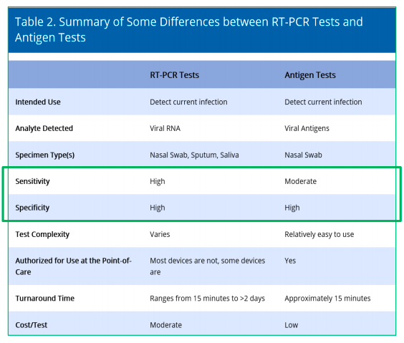
Molecular (PCR) vs Antigen Tests
Sensitivity: Accuracy of detecting positive patient with infection
Specificity: Accuracy of detecting negative patients without infection
https://qioprogram.org/sites/default/files/CMS-CDC%20Fundamentals%20of%20COVID-19%20Testing_10-08-2020_FNL_508.pdf
Notes:
Table from QIO Training
Clinical sensitivity: Accuracy of detecting positive patients with infection – lower sensitivity leads to higher false negative results
Clinical specificity: Accuracy of detecting negative patients without infection – lower specificity leads to higher false positive results
“A POC test that was inexpensive enough to use frequently would have a high sensitivity for detecting infections in time to act…” NEJM
Mina MJ, Parker R, Larremore DB. NEJM Sept 2020.DOI: 10.1056/NEJMp2025631

Slide 37
POC Antigen Testing
POC Antigen Testing
Authorized for use on symptomatic patients.
Use on asymptomatic patients is “off-label” but allowed.
CDC, FDA, HHS have issued guidance allowing off-label use and HHS guidance allows this guidance to override state restrictions.
Test results need to be confirmed in some situations.
CDC has published an algorithm/decision tree for interpreting antigen test results in the nursing home.

Slide 38
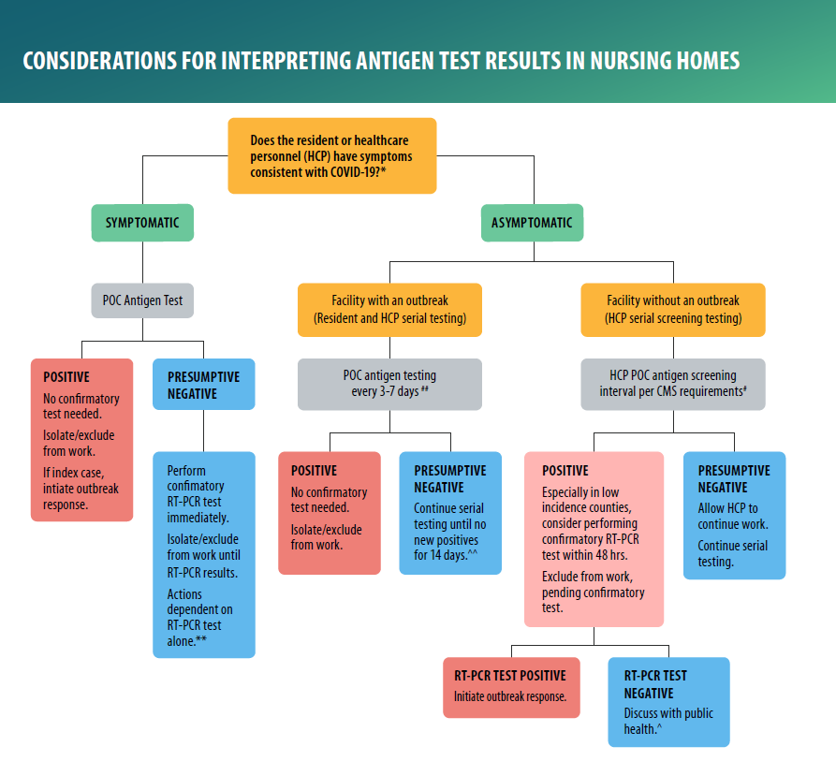
POC Antigen Test Results Decision Tree
Available from CDC:
https://www.cdc.gov/coronavirus/2019-ncov/downloads/hcp/nursing-home-testing-algorithm-508.pdf

Slide 39
Performing Antigen POC Testing
POC Antigen Testing
Training and proficiency in testing is needed for CLIA regulations. States may have further regulations.
Some states may require that you add the POC testing device to your CLIA certificate.
There is no federal restriction on who can be tested under the CLIA waiver.
Visitors are not required to be tested but it could be used for them depending on your state regulations.
Notes:
Ensure documentation and proof to support training and proficiency requirements.

Slide 40
Factors That Can Impact Test Results
Quality of the specimen collection
Proper use of the testing platform
Clinical presentation at the time of the test
Prevalence of COVID-19 in the area
Notes:
Inadequate sampling or mishandling of specimen can impact detection.
Staff should be proficient in sample handling and running the test, use of positive and negative quality controls
Did patient have a recent exposure or symptoms at the time of the test?

Slide 41
False Positive Antigen Test?
Inconsistent with the Clinical Picture
Asymptomatic patient
No risk factors
Gather Review Information
Review instructions for POC test for correct use
County with low prevalence
Ensure accuracy of test machine – procedural quality control tests
Compare % positivity for day/week to previous day/week to rule out operator error or test supply issue
Notes:
false-positive results may occur with any test even when sensitivity and specificity are very high, depending on a variety of factors.
A point-of-care test should be considered a possible false-positive when a positive test result appears inconsistent with the clinical situation (e.g., a positive antigen test in an asymptomatic person who does not have risk factors and resides in a community with lower COVID-19 prevalence). When a false-positive test is suspected, nursing homes and health departments should also review and gather the following information:
Review the FDA EUAexternal icon and instructions for use of the point-of-care antigen test to ensure correct use. For instance, the use of viral transport medium has been shown to produce false-positive results and should not be used for some antigen platforms (including BD Veritor and Quidel Sofia platforms).
Review recent control results to ensure accuracy of the antigen test machine. If able, perform procedural quality control tests to ensure correct operation of the machine.
Compare the percent positivity of the samples that were run that day (or week) to their previous percent positivity (e.g., their rolling 7-day average percent positive). Identifying many positives in one day might indicate an issue with the antigen results (either due to operator error or test supplies).
Consider the pre-test probability of disease. If testing a population with a COVID-19 prevalence of <1% (e.g., screening asymptomatic HCP in non-outbreak settings) with a single test with 99% specificity, the positive predictive value (probability that a positive test is a true-positive) could be <40%. If the prevalence is >10% (e.g., testing asymptomatic residents and HCP as part of an outbreak response) with that same test with 99% specificity, the positive predictive value may be >90%. Therefore, testing in low-prevalence populations with antigen or RT-PCR tests might produce false positives, but that is less likely in outbreak settings.

Slide 42
While Confirming Potential False Positive Antigen Test
IPC Measures Pending Confirmation of Potential False Positive Test Result
Asymptomatic Patient
Exclude HCP from work pending confirmatory testing
Place asymptomatic resident in Transmission-Based Precautions and in single room when possible (otherwise stay in current room).
Do not transfer resident to COVID unit or place in a different shared room with a new roommate.
Delay additional testing of asymptomatic residents or close contacts

Slide 43
Discordant Test Results
Conflicting tests such as a PCR and POC Antigen that have samples collected within 2 days = discordant test results
Suspected false positive antigen test result (patient asymptomatic) - ensure proper specimen collection and handling - then confirm with a PCR test.
Perform the test to confirm the result within 2 days of the initial test.
Explain false negative/false positive test results and your plan such as continued symptom screening.
Notes:
If confirmatory RT-PCR testing is performed in response to a positive antigen test and results are discordant (e.g., antigen test is positive, but the RT-PCR test is negative) the response should vary depending on the scenario:
Note that people who are asymptomatic at time of testing should continue to be monitored for symptoms. If an asymptomatic person with discordant test results begins to exhibit COVID-19–like symptoms in the subsequent week after testing, that person should be considered to have COVID-19 and placed in a COVID-19 unit under Transmission-Based Precautions (if resident) or excluded from work (if HCP). Repeat testing is not recommended in this situation.
If the person is asymptomatic and is not a known contact or part of a facility response to an outbreak, then the discordant test results could indicate a false-positive antigen test result. In this situation (particularly in lower prevalence areas), it is reasonable to continue symptom screening and test residents and HCP with COVID-19–like symptoms, and not institute the control interventions (e.g., facility-wide testing, excluding HCP with discordant results from work, moving resident with discordant results to a COVID-19 unit).
If discordant test results suggestive of a false positive antigen test are identified, facilities and health departments should notify the test manufacturer and the FDA

Slide 44
Positive Antigen Test, Symptomatic Patient
Confirming + Antigen Test with a symptomatic patient or patient in close contact with someone + is NOT recommended by CDC
However, if PCR testing was performed and is negative, then the facility still bases their plan on the positive antigen result
Exclude from work if HCP or place resident on COVID unit with transmission-based precautions
Expanded viral outbreak testing of residents and HCP indicated.
Notes:
Confirmatory RT-PCR testing after a positive antigen test result is not recommended in situations where the person being tested has COVID-19–like symptoms or had recent close contact with someone with SARS-CoV-2 infection (e.g., in an outbreak situation).
If, despite this guidance, RT-PCR testing was also performed and was negative, facilities should base their IPC actions on the positive antigen test result:
If the person is symptomatic, then they should generally be considered to have SARS-CoV-2 infection and placed in Transmission-Based Precautions on the COVID-19 unit (if a resident) or excluded from work (if HCP). Expanded viral outbreak testing of residents and HCP would be indicated.
If the person is asymptomatic but was tested after having close contact with someone with SARS-CoV-2 infection or as part of a response to an outbreak (e.g., facility has a resident with nursing-home onset COVID-19 or a HCP with COVID-19), then they should also be considered to have SARS-CoV-2 infection and managed as described above.
In the context of facility-wide testing in response to an outbreak, facilities might be more likely to consider the antigen test to be falsely positive if, for example, only a single positive result was identified in an resident who was asymptomatic and did not have close contact or reside on the same unit or floor where the person with COVID-19 was identified.

Slide 45
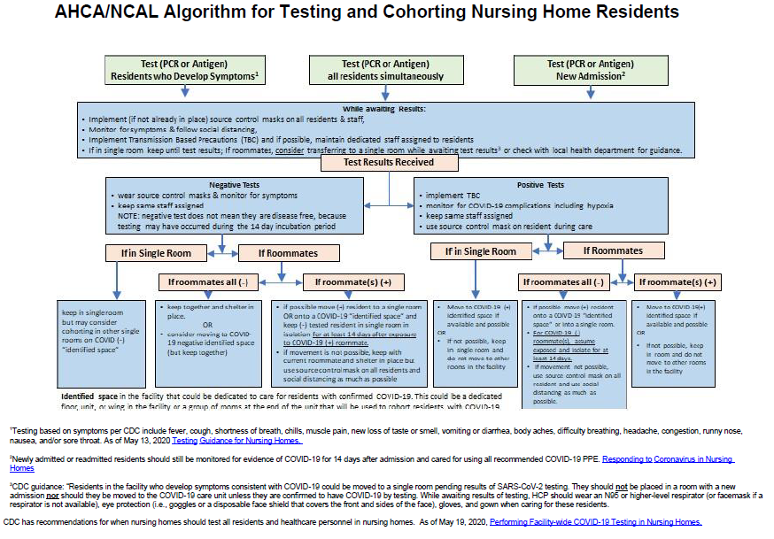
Cohorting of Residents

Slide 46
AHCA/NCAL Algorithm for Testing and Cohorting Nursing Home Residents
Test (PCR or Antigen)
Residents who Develop Symptoms
Test (PCR or Antigen)
All residents simultaneously
Test (PCR or Antigen)
New Admission
While awaiting Results
Implement (if not already in place) source control masks on all residents & staff,
Monitor for symptoms & follow social distancing,
Implement Transmission Based Precautions (TBC) and if possible, maintain dedicated staff assigned to residents
If in single room keep until test results; if roommates, consider transferring to a single room while awaiting test results or check with local health department for guidance
Test Results Received
Negative Tests
Wear source control masks & monitor for symptoms
Keep same staff assigned
Note: negative test does not mean they are disease free, because testing may have occurred during the 14 day incubation period
Positive Tests
Implement TBC
Monitor for COVID-19 complications including hypoxia
Keep same staff assigned
Use source control mask on resident during care
If in Single Room
If Roommates
If in Single Room
If Roommates
If roommates all (-)
If roommates(s) (+)
If roommates all (-)
If roommate(s) (+)
Keep in single room but may consider cohorting in other single rooms on COVID (-) *identified space*
Keep together and shelter in place.
OR
Consider moving to COVID-19 negative identified space (but keep together)
If possible move (+) resident to a single room OR onto a COVID-19 *identified space* and keep (-) tested resident in single room in isolation for at least 14 days after exposure to COVID-19 (+) roommate.
If movement is not possible, keep with current roommate and shelter in place but use source control mask on all residents and social distancing as much as possible
Move to COVID-19 (+) identified space if available and possible
OR
If not possible, keep in single room and do not move to other rooms in the facility
If possible move (+) resident onto a COVID-19 *identified space* or into a single room.
For COVID-19 (-) roommate(s), assume exposed and isolate for at least 14 days.
If movement not possible, use source control mask on all resident and use social distancing as much as possible.
Move to COVID-19 (+) identified space if available and possible
OR
If not possible, keep in room and do not move to other rooms in the facility

Slide 47
How to Report Test Data
Directly to state or local public health departments
According to state/local law or policy
Through a centralized platform
Such as the Association of Public Health Laboratories’ AIMS platform
Through a state or regional Health Information Exchange
HIE then to CDC as directed by the state

Slide 48
48-Hour Turnaround Time
Does the 48-hour turnaround time start at the time of specimen collection or when the lab receives the results?
HHI recommends starting at the time the specimen is collected. Facilities must document all efforts to meet the time frame.

Slide 49

Time Between Testing
What is the required timeframe between tests when testing twice weekly?
Answer: CMS has not specified a timeframe, HHI recommends 2 -3 days.

Slide 50
Testing Approach
What is the timeframe and approach to testing when our county is in the low or green, testing category with testing required once a month?
Answer: A great question that CMS has not specified. You could test a % of staff each week or test all the staff at the same time. Plan to test staff at the same time each month.

Slide 51
Outbreak Testing
When I have one staff member test positive within 14 days of being in the building during routine testing, do I then test everyone in the building or just on the unit?
Answer: This is an outbreak, and you must test everyone in the building.

Slide 52
Funding for Testing
2.5 billion from Provider Relief Fund
Approximately $1,500 per bed, more if allocated Incentive Payment Program funds
State may cover cost
Staff health insurance
Diagnostic only
Notes:
Part B and Medicare Advantage for diagnostic testing, Investigate if asymptomatic/presymptomatic residents might be covered by insurances or the state.
Part A: SNF pays

Slide 53
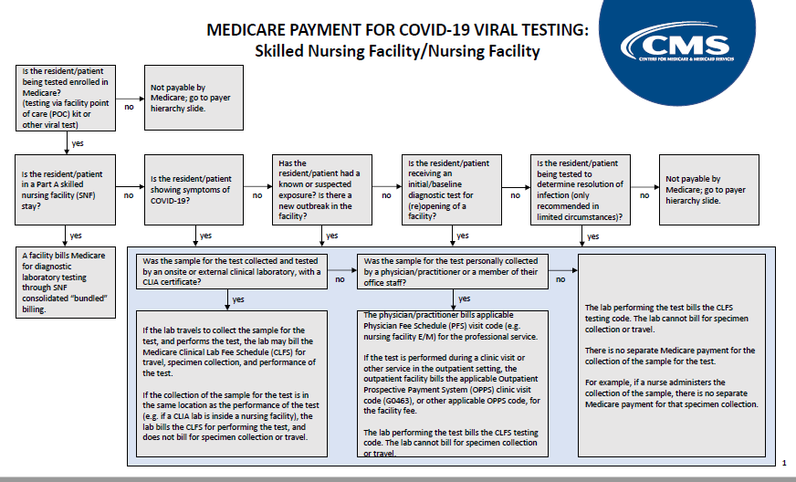
Medicare Payment for Testing
CMS Flowchart & Payer Hierarchy Information
Available at:
https://www.cms.gov/files/document/covid-medicare-payment-covid-19-viral-testing-flow-chart.pdf

Slide 54
Penalties
F886 citation
CMP based on scope & severity
Documentation of attempts to comply – surveyors not to cite for non-compliance
Notes:
Document attempts to get more tests or labs to do tests.
Must call local and state health depts if tests not available or taking more than 48 hours.

Slide 55
COVID-19 Focused Survey for Nursing Homes
Investigate Compliance with Infection Control
F880, F882,F885, F886, E0024
F884: Federal Surveyors only
Updated 8.25.20
Section 10 re: Infection Preventionist
Section 11 re: Staff & Resident Testing

Slide 56
Updates to Infection Control Survey
Added 2 Critical Elements
#10 CE Infection Preventionist
#11 CE Staff & Resident Testing
Instructions and Updates on Reopening Guidance and CDC Recommendations
Selecting a sample of residents
Guidance on tag F886
Questions related to hand hygiene, eye protection, ICP when moving between rooms & units, visitors, plans for cohorting, group activities, communal dining
Notes:
CMS Memorandum QSO-20-38-NH on August 26, 2020 Added a new requirement related to the testing of residents and staff for COVID-19 (F886) and provides surveyor guidance. • COVID-19 Focused Survey for Nursing Homes
Added two critical elements (CE)- #10 CE Infection Preventionist (IP) and #11 Staff and Resident Testing.
Added instructions for selecting a sample of residents and staff. Provided updates based on CMS’ Nursing Home Reopening Guidance (QSO-20-30-NH) and CDC recommendations.
• COVID-19 Focused Survey Protocol Revised to incorporate changes related to the nursing home testing requirements.
• Entrance Conference Worksheet Revised to include documentation related to the nursing home testing requirements.
• Mapping document Added the following tags: F847, F848, F882, F884, F885, F886 • F-Tag Job Aid- Added tags F882 and F886.
From https://www.cms.gov/Medicare/Provider-Enrollment-and-Certification/GuidanceforLawsAndRegulations/Nursing-Homes
August 26, 2020 QSO-20-37-CLIA,NH memo added new requirements for testing of residents/staff, updated CLIA requirements for reporting COVID test results,

Slide 57
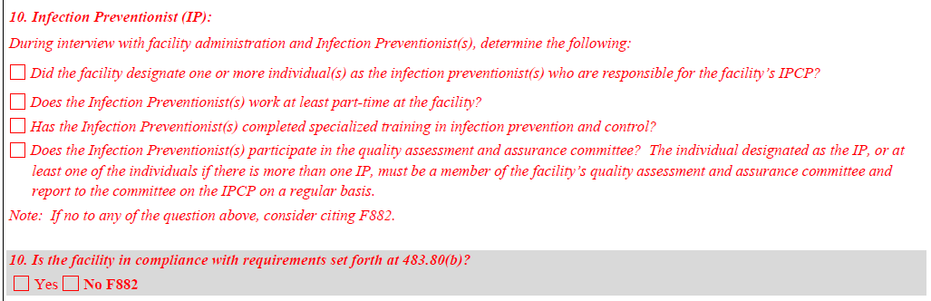
COVID-19 Focused Survey CE 10
Notes:
Tag F882 for not adhering to the Infection Preventionist requirement

Slide 58
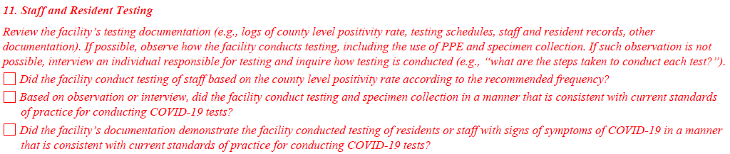
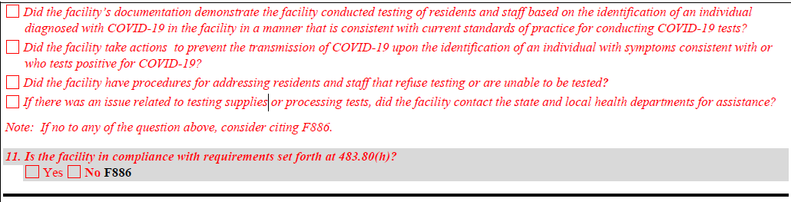
COVID-19 Focused Survey CE 11
Notes:
Tag F886 for not adhering to these Staff and Resident Testing regulations

Slide 59
CLIA Certificate of Waiver
Certificate of Waiver
Lab that performs only waived tests*
Effective for 2 years
Application (Form CMS-116) available online
*Waived tests are listed on the FDA website, defined as “simple laboratory examinations
& procedures that have an insignificant risk of erroneous result”
Notes:
Any laboratory located in a state that has a CMS approved laboratory program is exempt from CLIA certification. Currently, there are two states with approved programs: Washington and New York. New York has a partial exemption; therefore, if your laboratory is located in that state, contact the New York State Agency concerning your need for a CLIA certificate.
Ensure you are compliant with all CLIA laboratory regulations – check out Appendix C of the SOM, CLIA Statute and other resources listed at the end of this presentation.
You will need a CLIA certificate for each location where you perform testing, unless you qualify for one of the exceptions
Laboratories that are not at a fixed location; that is, laboratories that move from testing site to testing site, such as mobile units providing laboratory testing, health screening fairs, or other temporary testing locations may be covered under the certificate of the designated primary site or home base, using its address.
• Not-for-profit or Federal, State or local government laboratories that engage in limited public health testing (not more than a combination of 15 moderately complex or waived tests per certificate) may file a single application.
• Laboratories within a hospital that are located at contiguous buildings on the same campus and under common direction may file a single application for the laboratory sites within the same physical location or street address.

Slide 60
Enforcing Lab Reporting
CLIA certified labs will be identified as not reporting via survey and complaints
CMS is assessing automated methods to gather data for determining compliance
CLIA will be surveying 5% of Certificate of Waiver labs over 3 years
Failure to report will result in CMP of $1,000 for the first day of non-compliance and $500 for each additional day of non-compliance

Slide 61
Emotional Impact of Repeated Testing
Increased anxiety
PTSD, other conditions exacerbated
Notes:
Residents, esp those with dementia, PTSD may suffer physical and emotional distress from repeated testing that is uncomfortable.

Slide 62
Testing Recommendations from Providers
Antigen Machine Calibration
Look at # of tests
Facilities performing 1x/week instead of 1x/month due to frequent use
Testing Team
Clinical & Clerical for efficiency
Nurse to swab, clinical to record
Be Organized
Tracking state and federal requirements
Communicate & educate staff, residents, families
Notes:
Coordination is key

Slide 63
Choosing a Lab
Ability to provide results within 48 hours
Availability of Supplies
Ability to bill Medicare or Medicaid directly

Slide 64
Testing Strategy Tailored to the Clinical Situation
Testing alone is not enough!
Clinical Assessment
Transmission Prevention
Environmental Cleaning
Notes:
Testing is a technology and technology used incorrectly or without a broad strategy will likely fail.
Testing must be done in conjunction with other approaches. Look at individual clinical cases, screening for symptoms, provide stellar infection prevention and control….
“The good physician treats the disease; the great physician treats the patient who has the disease.” ~Sir William Osler

Slide 65
Further Information?
CMS Memorandum QSO-20-38-NH https://www.cms.gov/files/document/qso-20-38-nh.pdf
CMS Memorandum QSO-20-37-CLIA, NH https://www.cms.gov/files/document/qso-20-37-clianh.pdf
CDC Testing in Nursing Homes FAQs https://www.cdc.gov/coronavirus/2019-ncov/hcp/faq.html#Testing-in-Nursing-Homes
CDC Guidance on Antigen Tests https://www.cdc.gov/coronavirus/2019-ncov/lab/resources/antigen-tests-guidelines.html
FDA Information on COVID-19 Antigen Tests https://www.fda.gov/medical-devices/coronavirus-disease-2019-covid-19-emergency-use-authorizations-medical-devices/vitro-diagnostics-euas and https://www.fda.gov/medical-devices/coronavirus-covid-19-and-medical-devices/faqs-testing-sars-cov-2
Funding for Testing: https://www.cms.gov/files/document/se20011.pdf (MLN Matters Number SE20011)
CMS Press Release on Testing Methodology for Nursing Homes https://www.cms.gov/newsroom/press-releases/cms-updates-covid-19-testing-methodology-nursing-homes

Slide 66
Further Information?
CDC guidance on proper specimen collection:
See section “Recommendations for conducting swabbing” under CDC’s “Considerations for Performing Facility-wide SARS-CoV-2 Testing in Nursing Homes”: https://www.cdc.gov/coronavirus/2019-ncov/hcp/nursing-homes-facility-widetesting.html.
Influenza Specimen Collection: https://www.cdc.gov/flu/pdf/professionals/flu-specimencollection-poster.pdf.
Interim Guidelines for Collecting, Handling, and Testing Clinical Specimens from Persons for Coronavirus Disease 2019 (COVID-19): (https://www.cdc.gov/coronavirus/2019-ncov/lab/guidelines-clinical-specimens.html).
CDC’s Interim Laboratory Biosafety Guidelines for Handling and Processing Specimens Associated with Coronavirus Disease 2019 (COVID19): https://www.cdc.gov/coronavirus/2019-ncov/lab/lab-biosafetyguidelines.html#decentralized.
Guidelines for Safe Work Practices in Human and Animal Medical Diagnostic Laboratories: https://www.cdc.gov/coronavirus/2019-ncov/lab/lab-biosafetyguidelines.html.
For additional considerations for antigen testing, see CDC’s Interim Guidance for Rapid Antigen Testing for SARS-CoV-2.

Slide 67
CLIA Resources
CLIA Law & Regulations, https://www.cdc.gov/clia/law-regulations.html
CDC CLIA website, https://www.cdc.gov/clia/
FDA CLIA website, https://www.fda.gov/medical-devices/ivd-regulatory-assistance/clinical-laboratory-improvement-amendments-clia
MLN Matters MM11927 on Antigen Testing, MLN Matters MM11815 on Lab Fee Schedule
How to Obtain CLIA Certificate https://www.cms.gov/Regulations-and-Guidance/Legislation/CLIA/downloads/howobtaincliacertificate.pdf
State Operations Manual Appendix C on Labs https://www.cms.gov/Regulations-and-Guidance/Guidance/Manuals/Downloads/som107ap_c_lab.pdf
CLIA Statute https://www.govinfo.gov/content/pkg/USCODE-2011-title42/pdf/USCODE-2011-title42-chap6A-subchapII-partF-subpart2-sec263a.pdf
CLIA – Currently Waived Analytes https://www.accessdata.fda.gov/scripts/cdrh/cfdocs/cfClia/%20analyteswaived.cfm
CLIA State Survey Contacts https://www.cms.gov/Regulations-and-Guidance/Legislation/CLIA/Downloads/CLIASA.pdf
CLIA CMS Regional Office Contacts https://www.cms.gov/Regulations-and-Guidance/Legislation/CLIA/Downloads/CLIARO.pdf
You can email questions to the CMS Lab Excellence mailbox at: LabExcellence@cms.hhs.gov
Payment issues for SNF/NF testing that are outside the scope of the CLIA program should be referred to DNH_TriageTeam@cms.hhs.gov

Slide 68



Thank You!

Slide 69



Our Process
Prescribed medical record review process that encompasses HHI’s core business
HHI Regional HealthCARE Specialists provide expertise through teaching and training and an extensive chart audit process in order to ensure:
  MDS Accuracy
  MDS Supporting Documentation
  Billing Accuracy
  Nursing Documentation
  Therapy Documentation
  Clinically Appropriate Care

Slide 70


HHI
Services and Plans
  Gold C.A.R.E.S.
  2 Year Service Plan
Platinum C.A.R.E.S.
3 Year Service Plan
PDPM Training and Audits I Medicare I Compliance I Rehab Program Development I Seminars I MMQ Audits I Mock RAC Audits I Rehab Certification I Mock Health Inspection Survey I MDS Competency I Talent Management I Denials Management I Compliance Certification I Clinically Appropriate Stay I QAPI I QIS I Medicare Part B Program I MDSC Mentor Program I Case Mix Consulting I Professional Development I Leadership Trainings I Regulatory and Survey Assistance I Five Star I PBJ I Quality Measures I Analysis I Staff Training I Infection Control
and More!
List of HHI
Services
Silver C.A.R.E.S.
1 Year Service Plan
A La C.A.R.E.S.
Customized Service Plan

Slide 71



Our Senior
HealthCARE Specialists
Founded in 2001
Privately owned and operated
Ranked among Inc. Magazine’s top 5,000 fastest growing private companies in America three years in a row
Active monthly contracts in 24 states
Over 1,000 Skilled Nursing Facilities serviced
Over 3,000 Clinicians Certified on the MDS

Slide 72


https://www.harmony-healthcare.com/harmonyhelp
Live Support Available
8:00 a.m. – 5:00 p.m. EST
HarmonyHelp
The Knowledge Center is loaded with information that will assist with your daily responsibilities at your facility. This self-help site is broken up into 5 Sections:
With HarmonyHelp, Harmony Healthcare International (HHI) provides an invaluable resource for the entire interdisciplinary team. Imagine having questions answered by a Harmony HealthCARE Specialist within minutes of the inquiry. Fill out the form on the right to learn more about HarmonyHelp and our various Service Plans.
Manuals I Tools I C.A.R.E.S. Community I Hot Topics I FAQ (Frequently Asked Questions)

Slide 73






Connect
With Kris
kmastrangelo@harmony-heathcare.com
617.595.6032
@Krismastrangelo
@Krismastrangelo
@Krismastrangelo

Slide 74
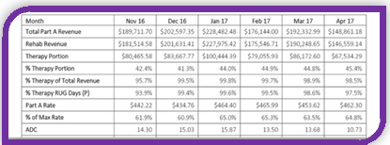
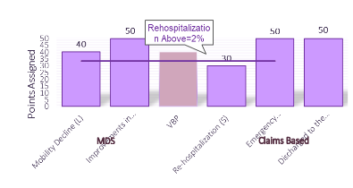
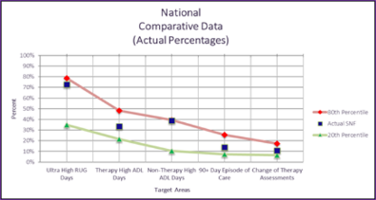
PDPM Revenue and Risk Analysis
Medicare Part A Revenue and Risk Analysis
Five-Star Quality Measure Points Analysis
PBJ Analysis
Staffing Analysis
PEPPER Analysis
Complimentary
HHI
Offerings
Notes:
74

Slide 75




harmonyhealthcareinternational I @KrisBharmony
harmonyhealthcareinternational I @KrisBharmonyseries
harmonyhealthcareinternational I @KrisBharmony
@harmonyhlthcare I @Krismastrangelo
Connect With Us and
Follow Our Weekly Blog

Slide 76
Marvelous Monday
Special Offer
Online access
Five-Star
Health Inspections
Staffing (PBJ and CMI)
Quality Measures
at a Discounted Rate
Today Only!
$69.99
Retail Value $199
Place Order Today 4.27.20

Slide 77
Thank You!

