Slide 1

Introduction to COVID-19 Vaccine
For Licensed Nursing Staff
Notes:
Hello and welcome to the education session on COVID-19 Vaccination Program. There is beginning to be more and more details about the COVID-19 vaccine, and this is an evolving situation so we will begin with letting you know what we currently know. Stay tuned to CDC, CMS and FDA as more information will be forthcoming.

Slide 2
Objectives
Upon completion of this presentation, participants should be able to:
Verbalize 3 key resource areas to access evolving guidance
Determine 2 actionable steps that can be started now to prepare for the COVID-19 vaccination plan
Notes:
We have 4 objectives for today’s presentation (read slides)

Slide 3

Current Status
Notes:
There are many questions that still will need to be answered when it comes to the vaccination for COVID-19. We will address what we know now and where to access information to begin discussing with your team
As health care workers, you may be asked about the vaccine, what you know and how the system works. Today we are going to be providing you with a brief overview. Keep in mind, the guidance is changing, and we will keep you up to date on the information as it is posted

Slide 4
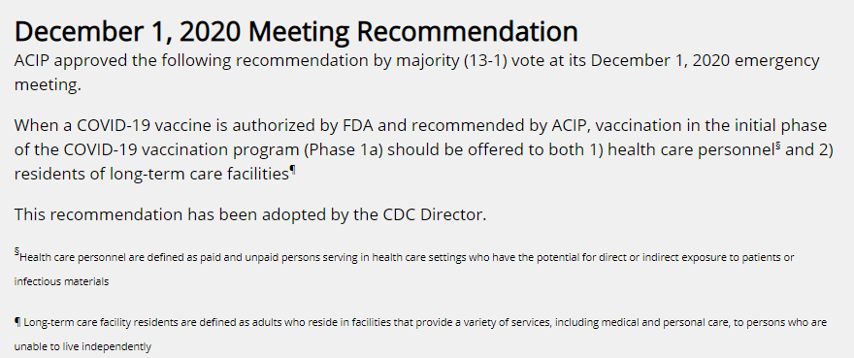
Advisory Committee on Immunization Practices (ACIP)
https://www.cdc.gov/vaccines/acip/index.html
Notes:
As many of you have seen in the news, the COVID-19 vaccine will not be available to the entire population initially, therefore, there is a process to determine who is at most risk and would benefit from the initial vaccine doses available. The Advisory Committee on Immunization makes these recommendations. On December 1, 2020 a Meeting was held and here are the Recommendations
ACIP approved the following recommendation by majority (13-1) vote at its December 1, 2020 emergency meeting.
When a COVID-19 vaccine is authorized by FDA and recommended by ACIP, vaccination in the initial phase of the COVID-19 vaccination program (Phase 1a) should be offered to both 1) health care personnel§ and 2) residents of long-term care facilities¶
This recommendation has been adopted by the CDC Director

Slide 5
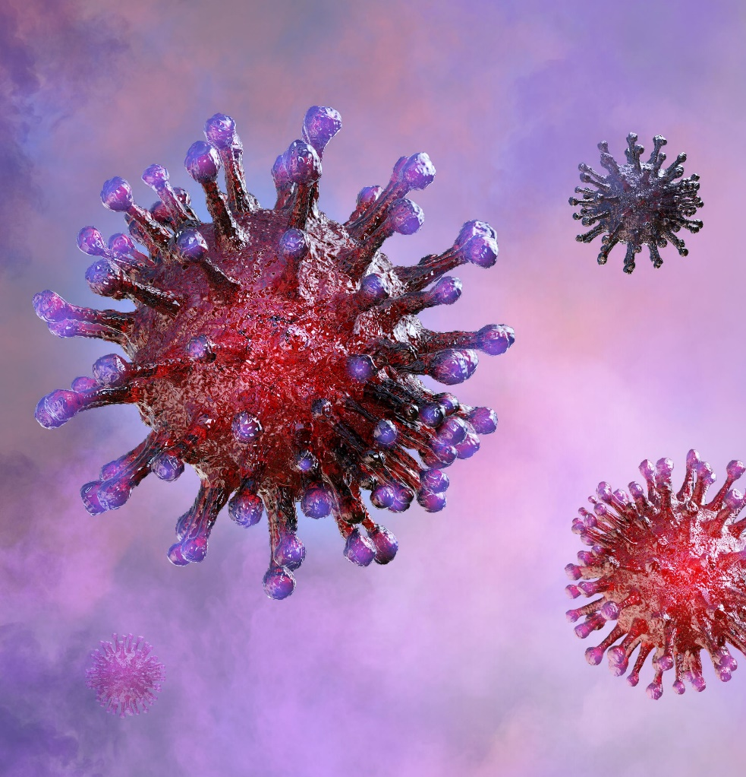
Immune System
Germ invades body
Attacks and multiplies (infection)
Immune system tries to fight infection
  Macrophages
  B-lymphocytes
  T-lymphocytes
https://www.cdc.gov/coronavirus/2019-ncov/vaccines/different-vaccines/how-they-work.html
Notes:
The CDC indicates, “To understand how COVID-19 vaccines work, it helps to first look at how our bodies fight illness. When germs, such as the virus that causes COVID-19, invade our bodies, they attack and multiply. This invasion, called an infection, is what causes illness. Our immune system uses several tools to fight infection. Blood contains red cells, which carry oxygen to tissues and organs, and white or immune cells, which fight infection. Different types of white blood cells fight infection in different ways:
Macrophages are white blood cells that swallow up and digest germs and dead or dying cells. The macrophages leave behind parts of the invading germs called antigens. The body identifies antigens as dangerous and stimulates antibodies to attack them.
B-lymphocytes are defensive white blood cells. They produce antibodies that attack the pieces of the virus left behind by the macrophages.
T-lymphocytes are another type of defensive white blood cell. They attack cells in the body that have already been infected.
The first time a person is infected with the virus that causes COVID-19, it can take several days or weeks for their body to make and use all the germ-fighting tools needed to get over the infection. After the infection, the person’s immune system remembers what it learned about how to protect the body against that disease.
The body keeps a few T-lymphocytes, called memory cells, that go into action quickly if the body encounters the same virus again. When the familiar antigens are detected, B-lymphocytes produce antibodies to attack them. Experts are still learning how long these memory cells protect a person against the virus that causes COVID-19”

Slide 6
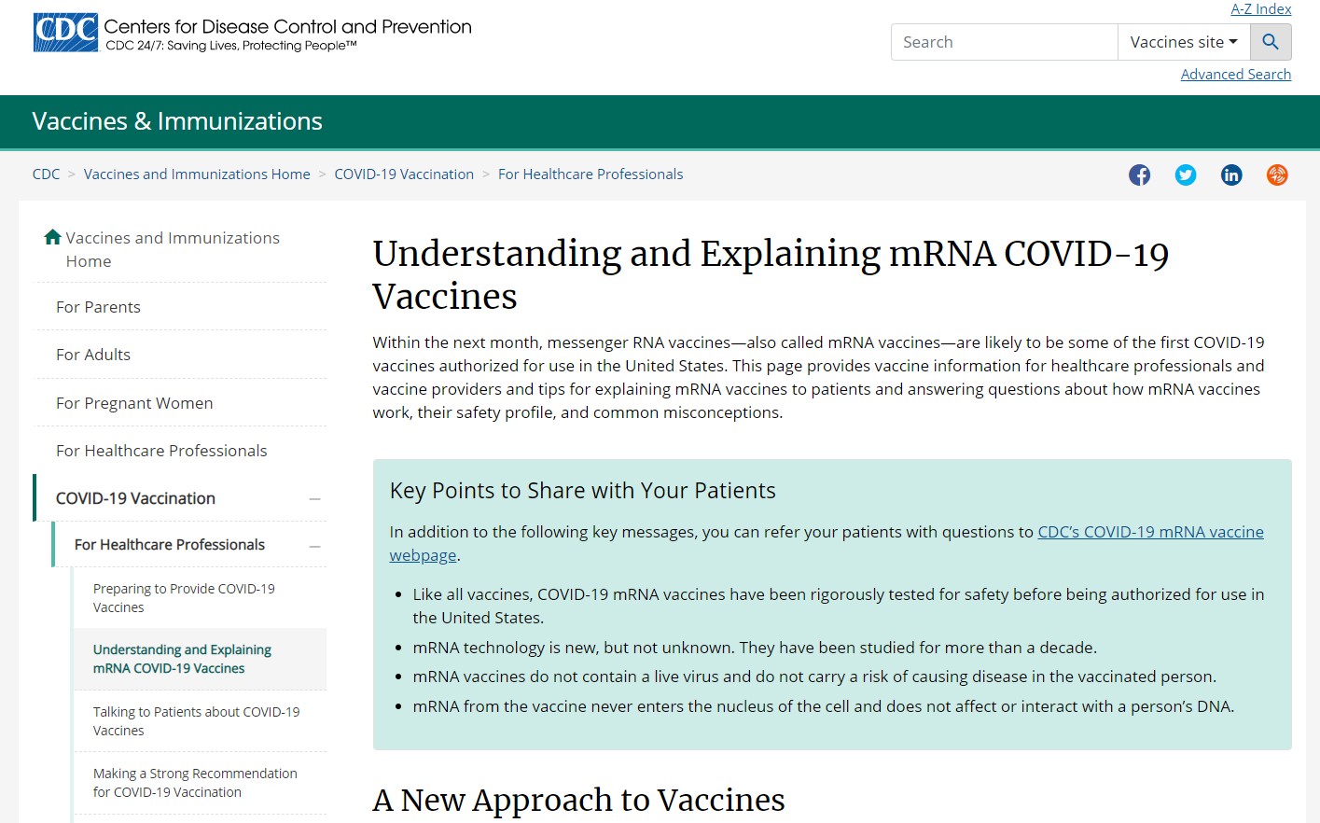
mRNA COVID-19 Vaccine
mRNA vaccines = messenger RNA vaccines
Do not contain a live virus
Does not affect or interact with an individual’s DNA
https://www.cdc.gov/vaccines/covid-19/hcp/mrna-vaccine-basics.html
Notes:
There are many questions that people have regarding the COVID-19 vaccine. There are also many misconceptions circulating regarding the mRNA vaccine. So, let’s discuss this a bit! The CDC has a website “Understanding and Explaining mRNA COVID-19 Vaccines” that provides key points to share with your patients. Key points include:
“Like all vaccines, COVID-19 mRNA vaccines have been rigorously tested for safety before being authorized for use in the United States.
mRNA technology is new, but not unknown. They have been studied for more than a decade. (in fact, there are currently no mRNA vaccines licensed in the United States)
mRNA vaccines do not contain a live virus and do not carry a risk of causing disease in the vaccinated person.
mRNA from the vaccine never enters the nucleus of the cell and does not affect or interact with a person’s DNA.”
The CDC also indicates that, ”mRNA vaccines take advantage of the process that cells use to make proteins in order to trigger an immune response and build immunity to SARS-CoV-2, the virus that causes COVID-19. In contrast, most vaccines use weakened or inactivated versions or components of the disease-causing pathogen to stimulate the body’s immune response to create antibodies.”

Slide 7
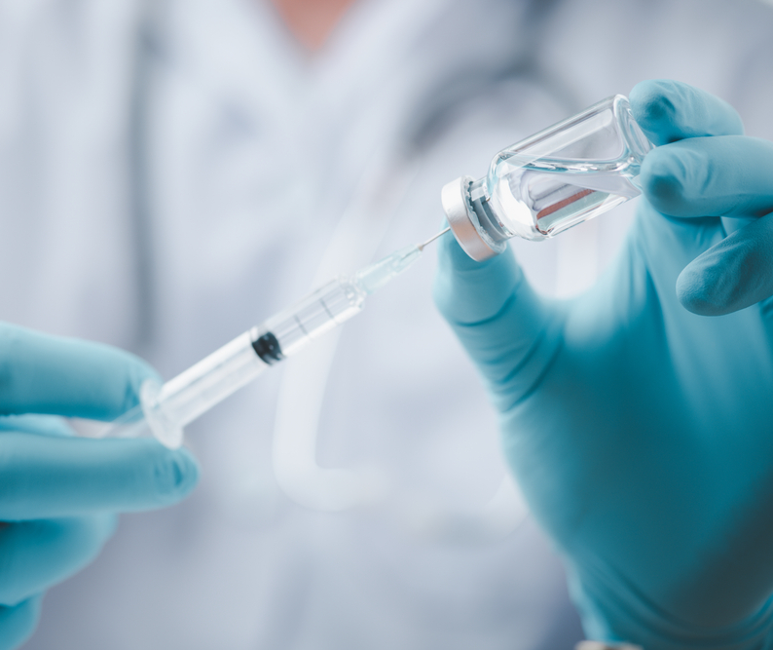
Types of Vaccines
mRNA vaccines
Protein subunit vaccines
Vector vaccines
https://www.astrazeneca.com/media-centre/press-releases/2020/azd1222hlr.html
Notes:
There are 3 types of COVID-19 vaccines that either are currently or will be undergoing Phase 3 clinical trials in the US.
mRNA (which include both the Pfizer and Moderna)
The Novavax vaccine contains purified pieces to trigger an immune response and have no live components
AstraZeneca uses a viral vector using an adenovirus that causes a common cold in chimpanzees, but in a weakened version, that scientists have replaced the genetic material for the same SARS-CoV 2 spike protein as the mRNA vaccine candidates to illicit making antibodies.
Janssen vaccine is a recombinant vector vaccine using a human adenovirus (which was modified so it does not replicate in humans) to express the COVID spike protein in cells. This vaccine is getting a lot of attention because it seems as if this one will require only one dose.

Slide 8
Websites for Details
Pfizer: https://www.pfizer.com/news/press-release/press-release-detail/pfizer-and-biontech-achieve-first-authorization-world
Moderna: https://investors.modernatx.com/news-releases/news-release-details/moderna-announces-primary-efficacy-analysis-phase-3-cove-study
AstraZeneca: https://www.astrazeneca.com/media-centre/press-releases/2020/azd1222hlr.html
Janssen: https://www.jnj.com/coronavirus/about-phase-3-study-of-our-covid-19-vaccine-candidate
Novavax: https://ir.novavax.com/news-releases/news-release-details/novavax-covid-19-vaccine-granted-fast-track-designation-us-fda
Notes:
The websites listed will provide the press release from each manufacturer regarding their vaccine information.

Slide 9
mRNA Vaccines
Overview
Notes:
We are going to discuss mRNA as these are the first 2 vaccines that we may see—and there is a LOT of discussion about these vaccines.

Slide 10
mRNA COVID-19 Vaccines
Strands of genetic material (mRNA) in special coating
Instructions for the cell how to make a piece of “spike protein”
The cell breaks down the mRNA strand (mRNA strand never enters the cell’s nucleus)
Once on the cell surface, the protein or antigen causes the immune system to produce antibodies
https://www.cdc.gov/vaccines/covid-19/hcp/mrna-vaccine-basics.html
Notes:
The CDC indicates, “mRNA vaccines have strands of genetic material called mRNA inside a special coating. That coating protects the mRNA from enzymes in the body that would otherwise break it down. It also helps the mRNA enter the muscle cells near the vaccination site.
mRNA can most easily be described as instructions for the cell on how to make a piece of the “spike protein” that is unique to SARS-CoV-2. Since only part of the protein is made, it does not do any harm to the person vaccinated but it is antigenic.
After the piece of the spike protein is made, the cell breaks down the mRNA strand and disposes of them using enzymes in the cell. It is important to note that the mRNA strand never enters the cell’s nucleus or affects genetic material. This information helps counter misinformation about how mRNA vaccines alter or modify someone’s genetic makeup.
Once displayed on the cell surface, the protein or antigen causes the immune system to begin producing antibodies and activating T-cells to fight off what it thinks is an infection. These antibodies are specific to the SARS-CoV-2 virus, which means the immune system is primed to protect against future infection.”
The CDC also indicates that there are both numerous preclinical and clinical studies using mRNA to encode cancer antigens in order to stimulate immune responses that target at either clearing or reducing malignant tumors.

Slide 11
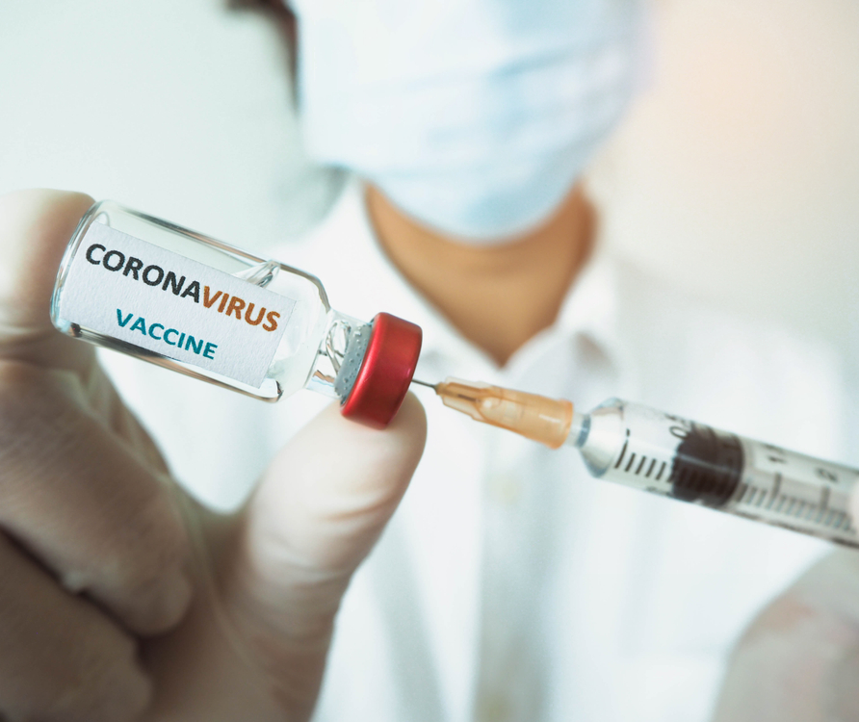
Benefits of the mRNA Vaccine
Non-infectious element
Manufacturing times are shorter
Can be developed in a lab
Process can be standardized
“In the future, mRNA vaccine technology may allow for one vaccine to target multiple diseases”
https://www.cdc.gov/vaccines/covid-19/hcp/mrna-vaccine-basics.html
Notes:
(Read slide) These vaccines will have to go through the same rigorous safety assessment as all vaccines, according to CDC, before they are authorized or approved by the FDA for use in the US. Remember, because they are not LIVE vaccines, they do not pose a risk of causing disease in the person that is vaccinated

Slide 12
Facility Planning
Beginning a COVID-19 Vaccination Plan

Slide 13

QAA Committee Meeting
Initial QAA Committee Meeting to begin planning, to include (at a minimum):
  Administrator
  DON
  Medical Director
  Infection Preventionist
  Pharmacy Consultant

Slide 14

Pharmacy Involvement
Notes:
The pharmacy will be administering the first wave of vaccines and follow up. As more information is available, we will let you know what will happen after this. The facility will still be responsible for setting up the dates with the pharmacy, obtaining the consents, providing billing information, making sure documentation is in the medical record and monitoring for any adverse reactions.

Slide 15

Authority AND Backup
Infection Preventionist and one other RN
Notes:
The Infection Preventionist (name) and one other RN (name) are going to be the facility contact and lead employees for the COVID-19 vaccination program. If you have any questions, it is important that you ask them.

Slide 16
Watch for EUA Fact Sheet
COVID-19 disease description
Dosage and administration information
Storage and handling instructions
Dose preparation and administration information
Requirements for use of vaccine under EUA
Risks and benefits, including common adverse events (AEs)
Any approved available alternatives for preventing COVID-19
Reporting requirements, including reporting AEs to VAERS
Additional resources
https://www2.cdc.gov/vaccines/ed/covid19/
Notes:
A Vaccine Information Sheet (VIS) from CDC is typically not provided for vaccines under emergency use authorization, therefore an EUA Fact sheet will provide information including risks, benefits and common adverse events. This information will be provided in order for us to give good information to residents or resident representatives and all of you in order to make an informed decision on the vaccine. This Fact sheet also provides valuable information relating to how to handle and administer the vaccine, risks and benefits, alternatives, reporting and additional resources. Many of you are familiar with the CDC Vaccination Information Sheet or VIS for the other vaccines we give. Typically VIS sheets are not posted on the CDC website until a vaccine is licensed. This is why you will use the EUA fact sheet.

Slide 17

Resident/Representative Education
Informed Consent
  Benefits
  Types
  Side Effects
  Meets ADA requirement
    https://www.cdc.gov/coronavirus/2019-ncov/vaccines/vaccine-benefits.html
Notes:
Informed consent for residents/employees
Benefits: https://www.cdc.gov/coronavirus/2019-ncov/vaccines/vaccine-benefits.html
Types: https://www.cdc.gov/coronavirus/2019-ncov/vaccines/different-vaccines.html
Side Effects
Meets the requirements of the Americans with Disabilities Act, the Rehabilitation Act, the Patient Protection and Affordable Care Act, the Plain Language Act, and other applicable disability rights laws for accessibility

Slide 18
After the Pharmacy Clinics
Thoughts for Moving Forward
Notes:
We don’t know what the process will be yet after the initial vaccination clinics by the pharmacy. As we hear more, we will let you know. However, if the facility will be providing the vaccine after the initial program implementation, we will need to consider several areas for education and competency.

Slide 19

Gather Information About Vaccine for Planning
Policy and Procedure
Employee Education
Which vaccine will be delivered
Develop Standard Operation Procedures
Documentation
Preparation planning
Administration Priority
Pre-plan for 2nd dose
Notes:
Which vaccine will be delivered-prepare education using the EUA fact sheet for vaccine recipients (VISs may not be produced until after the vaccine has been licensed)
Develop standard operation procedures for storage and handling
https://www.cdc.gov/vaccines/hcp/admin/storage/toolkit/storage-handling-toolkit.pdf
CDC recommends a digital data logger (DDL) to provide the most accurate storage unit temperature information (includes details on how long a unit has been operating outside the recommended temperature range)
Policy and procedure for calibration testing every 1-2 years or according to manufacturer’s suggested timeline
Documentation of log
Maintain data for at least 3 years to analyze trends
Determine any mixing with diluent, needle size, anatomic sites, etc.
Documentation and reporting of vaccine wastage/spoilage
Determination of administration priority in the event that there is not adequate supply for all residents and employees
Planning and scheduling for vaccines that require 2nd dose

Slide 20

Policy and Procedure
Notes:
At this time, until further information is forthcoming, let group know that a policy and procedure will need to be developed once the process is set up with pharmacy –AND moving forward afterwards

Slide 21
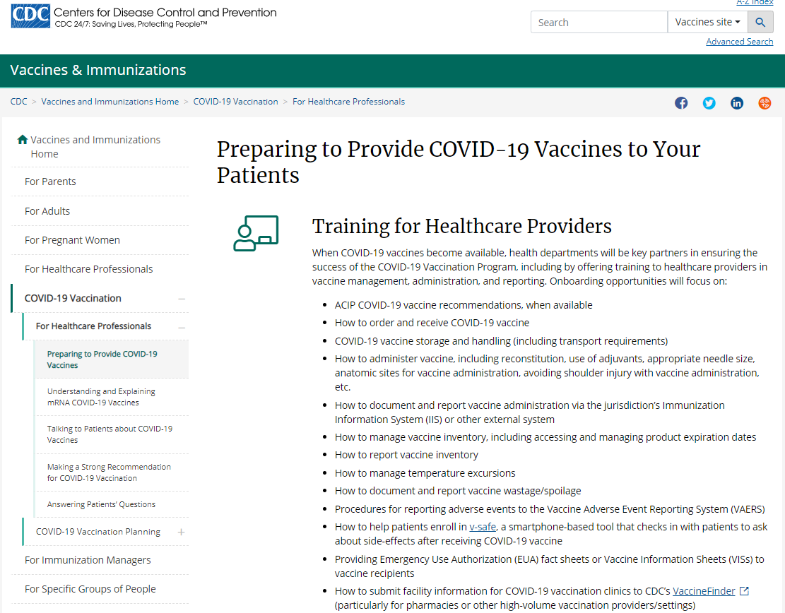
CDC Resource to Review
https://www.cdc.gov/vaccines/covid-19/hcp/prepare.html
Notes:
Here are some CDC websites to visit. This one is a great webpage for all leaders to review on “Preparing to Provide COVID-19 Vaccines to Your Patients”

Slide 22
Employee Education
Which Vaccine will be administered
Education prior to administration
  Pharmacy Involvement
  Receipt, storage and handling
  Organization and rotating
  Temperature requirements and monitoring
  Expired vaccine
  Compromised Vaccine
  Waste/disposal of Vaccine
  Preparation, administration and safety of vaccine
  Assessment prior to administration
  Vaccine administration errors
  Monitoring
    Anayphylaxis Management
  Documentation
  Follow-up
  Refusals
  Orders
  Competency
  Reporting
Notes:
Initial education will include the facility responsibilities for consent, communication, space and follow up for the Pharmacy to administer the initial COVID-19 vaccines. Following this, if the facility will be planning to administer the vaccine at a later time, here are some of the topics that will need to be educated along with competency verification.

Slide 23
Management of Anaphylaxis
“Rapidly assess airway, breathing, circulation, and mentation (mental activity).
Call for emergency medical services.
Place the patient in a supine position (face up), with feet elevated, unless upper airway obstruction is present or the patient is vomiting.
Epinephrine” (Add facility standing order)
https://www.cdc.gov/vaccines/covid-19/info-by-product/pfizer/anaphylaxis-management.html
Notes:
All residents and staff who receive the COVID-19 vaccine should be observed after vaccination:
Persons with a history of anaphylaxis due to any cause for at least 30 minutes—all other persons for 15 minutes
Emergency equipment and staff trained in CPR should be available at all times
Pulse Oximeter
Oxygen
BP cuff
Epinephrine prefilled syringe or autoinjector-at least 3 doses on site
(Discuss facility procedure)

Slide 24

In Summary
Notes:
In summary, as we are learning more about the available vaccines, FDA Emergency Use Authorizations, State and Federal guidance, we will have even more details to provide system development and implementation, staff training and education to the residents/representatives. We will keep you all in the loop as more information becomes available.

Slide 25


Slide 26
References and Resources
Centers for Disease Control and Prevention. Understanding and Explaining mRNA COVID-19 Vaccines: https://www.cdc.gov/vaccines/covid-19/hcp/mrna-vaccine-basics.html
Centers for Disease Control and Prevention. COVID-19 Vaccination Training Programs and Reference Materials for Healthcare Professionals. 11.24.20 : https://www.cdc.gov/vaccines/covid-19/downloads/COVID-19-Clinical-Training-and-Resources-for-HCPs.pdf
Centers for Disease Control and Prevention. Advisory Committee on Immunization Practices (ACIP): https://www.cdc.gov/vaccines/acip/index.html

Slide 27
References and Resources
Centers for Disease Control and Prevention. Understanding How COVID-19 Vaccines Work: https://www.cdc.gov/coronavirus/2019-ncov/vaccines/different-vaccines/how-they-work.html
Centers for Disease Control and Prevention. COVID-19 Vaccine Training Module. November 19, 2020: https://www2.cdc.gov/vaccines/ed/covid19/
Centers for Disease Control and Prevention. COVID-19 Vaccination Program Interim Playbook for Jurisdiction Operations. October 29, 2020: https://www.cdc.gov/vaccines/imz-managers/downloads/COVID-19-Vaccination-Program-Interim_Playbook.pdf

Slide 28
References and Resources
Centers for Disease Control and Prevention. COVID-19 ACIP Vaccine Recommendations: https://www.cdc.gov/vaccines/hcp/acip-recs/vacc-specific/covid-19.html
Centers of Disease Control and Prevention. Interim Considerations for the Potential Management of Anaphylaxis at COVID-19 Vaccination Sites: https://www.cdc.gov/vaccines/covid-19/info-by-product/pfizer/anaphylaxis-management.html

Slide 29
Disclaimer
“This presentation provided is copyrighted information of Pathway Health. Please note the presentation date on the title page in relation to the need to verify any new updates and resources that were listed in this presentation. This presentation is intended to be informational. The information does not constitute either legal or professional consultation. This presentation is not to be sold or reused without written authorization.”

