Slide 1
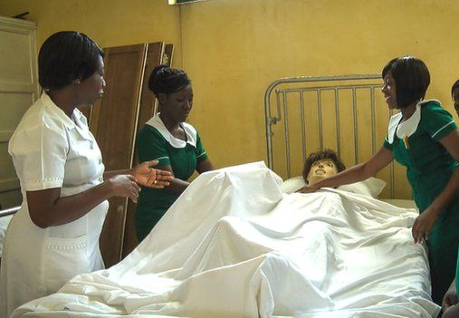
Africa Human Capital Nursing (AHCN)
U.S.A. Program Sponsorship
Presentation Prepared by: Cross Atlantic Healthcare Partners, LLC
November 2023

Slide 2
"Bridging the rich tapestry of cultures between the United States and Africa is a harmonious symphony that celebrates diversity, embraces unity, and fosters understanding. In the exchange of traditions and stories, we build bridges that connect hearts across continents, weaving a fabric of shared experiences that transcends borders and cultivates a global community."

Slide 3
Important Notice and Disclaimer
DISCLAIMER
The following presentation, the information communicated during any delivery of the presentation and any question-and-answer session, and any other materials distributed at or in connection with the presentation (collectively, this “presentation”) has been prepared by Cross Atlantic Healthcare Partners, LLC and its affiliates. This presentation is intended for the recipient hereof only and may not be reproduced or distributed, in whole or in part without the prior written consent of Cross Atlantic Healthcare Partners, LLC.
This presentation and information contained herein constitutes confidential information and is provided to you on the condition that you agree that you will hold it in strict confidence.
The distribution of this presentation may also be restricted by law and persons into whose possession this presentation comes should inform themselves about and observe any such restrictions.

Slide 4
List of Contents
Agenda
Introduction and Primary Program Goals.
Global Context.
Operating Model.
Discovery and Sponsorship Selection.
Sponsorship Needs Assessment.
Sponsorship Next Steps.

Slide 5
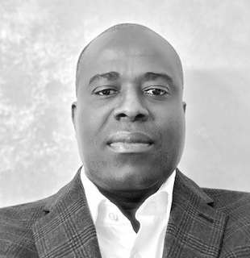
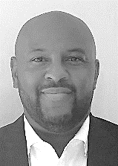
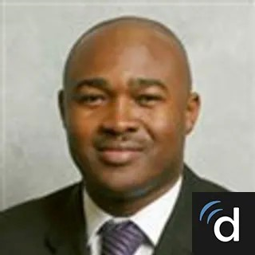
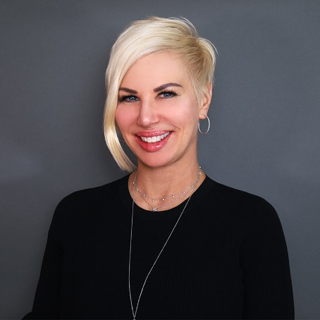
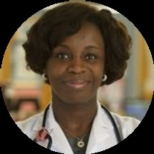
Team and Advisory Network
Edmund K. Aziabor
Leslie A Nelson
Founder of Cross Atlantic Health Partners LLC. ; Succor Home Care LLC; Entrepreneur.
Former Banking and Finance Executive.
Former Director at Fidelity Investments and Bank of America/ Merrill Lynch.
University of Ghana, MBA MIT Sloan School of Management.
Entrepreneur & Senior Business Executive with extensive experience in Africa (Private Equity, Energy, Healthcare and Finance.
Former Managing Director New Fortress Energy (NASDAQ: NFE), former GE Senior Executive in Africa , former expeience with Merrill Lynch/ Bank of America and UBS Financial.
University of Ghana BA Hons, MBA NYU Stern School of Business, New York.
Kris B. Harmony
Dr. Kwame Larbi-Siaw
Entrepreneur, Consultant, Keynote Speaker, Educator and Advocate.
Founder, President and CEO Harmony Healthcare International, (HHI).
Founder, President and CEO KrisBHarmony, LLC.
Tufts University, B.S.O.T., Salem State University M.B.A., LNHA, OTR/L.
American Board of Internal Medicine Certified.
Attending Hospitalist at Caromont Medical Center, Internal Medicine, Intensive care & Post Acute Care.
University Of Ghana Medical School; Columbia University College of Physician & Surgeons at Harlem Hospital Center.
Dr. Yvonne F. Wilson
Doreen Akoi-Gyebi
American Board of Internal Medicine Certified.
Primary Care Medicine at Mass General Brigham.
Internal medicine, Inpatient Medicine, Long Term Care.
Wellesley College, MD Harvard Medical School, Columbia University.
New Jersey Board of Nursing Certified.
Critical/Intensive Care Nursing, Telemetry & Medical Surgical Nursing.
Long Term Assisted Care/Assisted Living, Sub-Acute Care Nursing.
University of Science & Technology, Jersey College School of Nursing, Capella University.

Slide 6
Introduction and Primary Goals

Slide 7
Introduction and Primary Program Goals
Our Vision: To bridge the global resource gap by matching supply of skilled human capital from Developing markets with Healthcare service providers in developed markets such as the U.S.A. and Europe.
Who Are We?
Cross Atlantic Healthcare Partners, LLC is a New England based company established to provide healthcare staffing services.
Opportunity
The current shortage of Registered Nurses (RN) and other healthcare professionals in the U.S. has led to a crisis for healthcare providers. Everyone wants to come to the U.S. There are migrant nurses from Africa available to help the sponsoring healthcare organizations provide the quality of care and meet the staffing requirements mandated by the government.
Primary Program Goals
Fill the existing staffing shortages with migrant nursing practitioners.
Reduce the recruiting and affiliated costs for healthcare organizations.
Provide qualified African RNs with opportunities to improve their lives.

Slide 8
Cross Atlantic Operating Model

Slide 9
Recruitment Alternatives: The Hiring Hypothesis
Pathway
1
Pathway
2
Candidate must be a Registered Nurse (RN) in Home Country.
Candidate completes IELTS (International English Language Test) certification.
Nurse will apply for Statement from Commission on Foreign Graduate Nurses (CGFNS)
US Based Healthcare Sponsor provides Job Offer as Certified Nursing Assistants (CNA) and support letter for Visa process (H-1B or E-3B Visa).
Migrant Nurse commences employment in US as CNA with goal to transition to RN status.
Upon passing NCLEX exam certification Migrant nurse transitions to Registered Nurse.
Candidate must be a Registered Nurse (RN) in Home Country.
Candidates to complete IELTS (International English Language Test) certification.
Nurse will apply for Statement from Commission on Foreign Graduate Nurses (CGFNS).
Nurse will travel to South Africa or India and take the NCLEX Exam and receive certification.
US Based Healthcare Sponsor provides Job Offer for Registered Nurse position and support letter for Visa process (H-1B or E-3B Visa).
Migrant Nurse commences work immediately as a Registered Nurse in designated U.S. State.

Slide 10
Global Context: Where Demand Meets Supply

Slide 11
USA: The Demand – Current Situation
State of Affairs
Reasons for the Shortage
124K
The US is projected to face a shortage of up to 124,000 physicians by 2034 as the demand outpaces supply*.
Population growth and aging.
Increased access to healthcare leading to higher demand for healthcare.
Many healthcare workers are approaching retirement age and are not being replaced at the same rate.
Burnout leading to high turnover.
Hostility toward nurses in the healthcare setting.
Balancing family – majority of nurses are women and may leave or pause their careers when they have a family.
Starbucks.
200K
200,000 nurses must be hired each year to meet rising demands.
A shortage of home health aides is most acute.
1.1M
Hospitals are suffering a “national emergency,” projecting the overall shortage of nurses to reach 1.1 million by the end of 2023.
Increase in the aging population (Baby Boomers) - People in this demographic often require more medical care. The over-65 population will grow by 48% by 2032.
The Solution
Recruiting foreign trained healthcare professionals to fill gaps in the workforce.
Training programs to address skilled gaps.
Interprofessional collaboration to optimize the healthcare workforce and improve patient care.
Retention efforts: improving working conditions, offering competitive salaries, and addressing issues of burnout.
Unfortunately, many working physicians will also be reaching retirement age along with the rest of the Baby Boomers.
Some nurses move to specialized areas rather than remaining in primary care, where there is the highest need.
*Association of American Medical Colleges (AAMC)

Slide 12
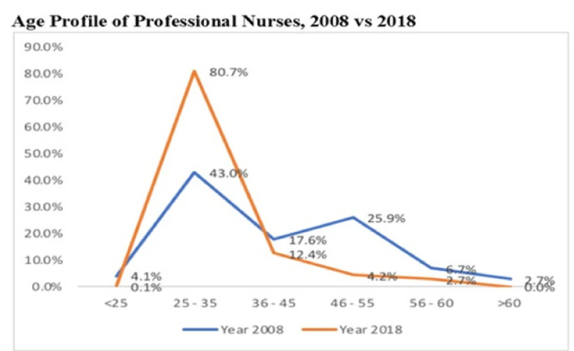
Africa: The Supply - Current Situation
Healthcare professionals are migrating from Africa to developed countries in search of better professional and personal opportunities. In recent years, this phenomenon has accelerated significantly.
Healthcare professionals from South Africa, Ghana and Nigeria are in high demand in the USA and UK.
3K
In 2022 more than 3,000 nurses migrated from Ghana for greener pastures because of the unemployment situation, unfair salary scales and poor conditions of service.
South Africa: A consistent increase in the number of health professionals who are willing to migrate.
The UK, Americas, Australia and Ireland generally offer better working conditions, flexible work schedules and better pay hence emigration to these locations.
Ghana: The period shows an increase of more than 80% enrollment into professional nursing.
81% of professional nurses are younger than 35 years compared to 2008 which was 43%.
Ghana is an imminent bilateral agreement with the British Government to send Ghanaian trained Nurses to the United Kingdom (UK) in exchange for financial considerations.
Ghana has a similar agreement with Barbados where nurses are excelling.

Slide 13
Discovery and Sponsorship Selection

Slide 14
Sponsorship Needs Assessment

Slide 15
Sponsorship Next Steps

Slide 16
Contact Us:
Thank you!
Edmund Aziabor MBA
edaziabor@succorhomecare.com
edaziabor@alum.mit.edu
201.417.6533
Leslie Nelson MBA
niiaruna@hotmail.com
+233.24.814.8056
Kris B. Harmony OTR/L, LNHA, MBA
kris@krisbharmony.com
617.595.6032

